Slide 1

Yapp Application
(Turning Images and Audio into Creative Media)
Syed Shah Abdur Rehman 03-134221-056
Abdullah Rabbani 03-134221-001
Affan Ahmad 03-134221-003

Slide 2
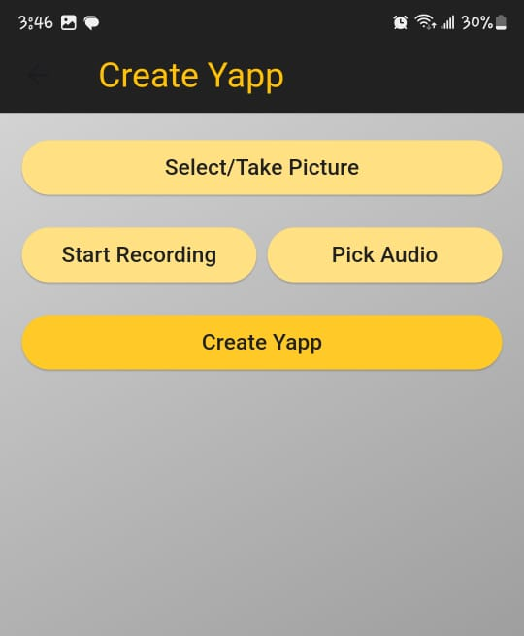
Demo of the Application
Select or capture an image.
Record or upload audio.
Combine and save as a video.

Slide 3
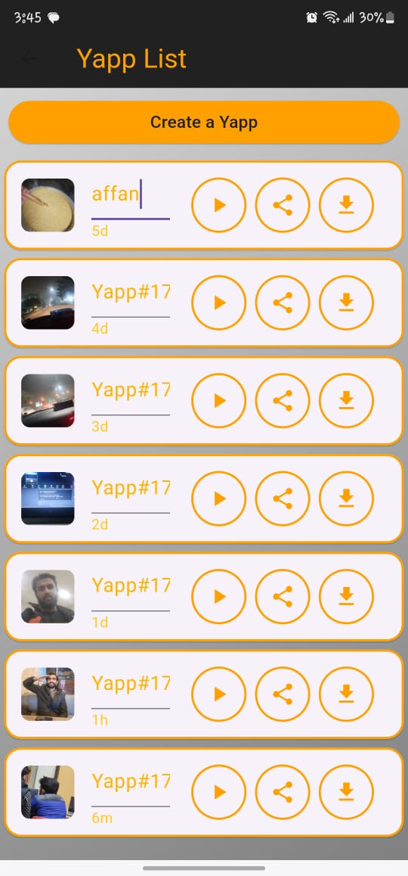
Demo
Managing Yapps (rename, delete).
Rename the yapp,
Delete one or all yapps by selection
Sharing Yapps through social platforms.

Slide 4

Design and Development Process
Provider-based state management.
Modular and scalable structure.
Flutter, FFmpeg, Provider, VideoPlayer.
Implementing media processing and management features.
Testing and debugging for cross-platform compatibility.

Slide 5
Strengths of the Application
Seamless combination of image and audio.
Real-time updates using Provider.
Easily extendable for future features.

Slide 6
Weaknesses of the Application
No cloud integration.
Slight delay for larger Yapps.

Slide 7
Challenges Faced
Media File Handling
Recording Audio Integration

Slide 8
Future Enhancements
Future Enhancements
Advanced Editing Features
Shared editing and group Yapps creation

Slide 9
Why Yapp?
Combines creativity and simplicity in a single platform
A tool for personalized multimedia creation and sharing.
An app to save memories

